Slide 1
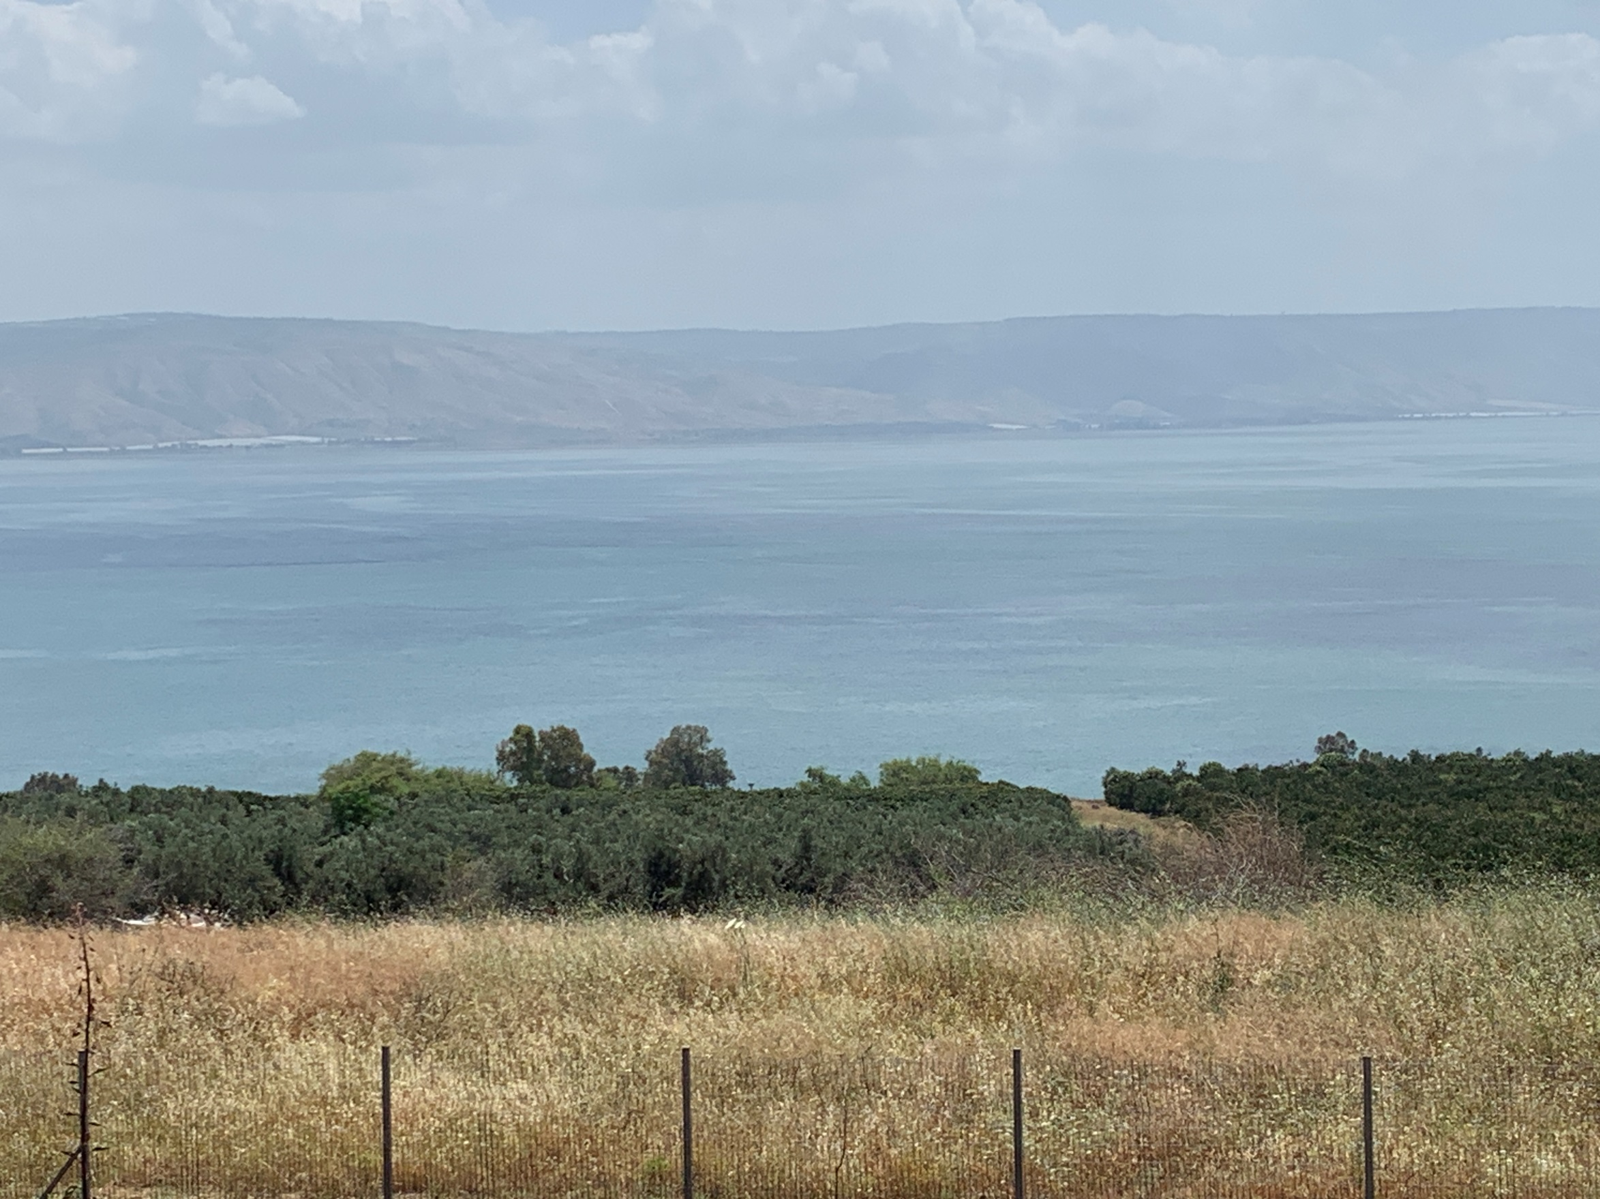
Sermon on the Mount

Slide 2
Blessed are the
Poor in spirit
Theirs is the
Kingdom of Heaven

Slide 3
Blessed are those that
Mourn
They shall be
Comforted

Slide 4
Blessed are the
Meek
They shall
Inherit the Earth

Slide 5
Blessed are those who Hunger / Thirst after righteousness
They shall
Be Satisfied

Slide 6
Gentleness - Matthew 5:1-6
James 4:8-10
Psalm 32:3-5
2Cor. 7:8-11

Slide 7
Gentleness - Matthew 5:1-6
Eph 4:1-3; 2Tim. 2:23-25
Psa. 37:3-11; Phil. 3:8-9; Rom. 6:12-14

Slide 8
Blessed are the MERCIFUL
They shall receive MERCY

Slide 9
Merciful - Matthew 5:7
Luke 10:25-37
Who is my neighbor?

Slide 10
Merciful - Matthew 5:7
Compassionate love to all in action!
Transformation that others will notice!
Culture
Economics
Social circles
Religious affiliations
We need the Lord’s compassion flowing through us for their spiritual healing!

Slide 11
Merciful - Matthew 5:7
It is NOT about:
Selective opportunities for best impact.
Manipulation for “self” advantages.
A way to display for others to see!
Telling about it to “encourage” by example
Prov. 27:2; Matt. 6:3-4; Jer. 9:23-24
If we do… NO Mercy

Slide 12
Merciful - Matthew 5:7
It is about transformation into Christ.
Matt. 18:21-35
We did not deserve mercy but
Jesus gave it
Not lovely but
He loves us
Dead in sin –
gave His life so we might live
He did not wait till we understood before acting.
His mercy move Him from heaven to save

Slide 13
Merciful - Matthew 5:7
John 8:1-11
Acts of underserved kindness can change someone completely

Slide 14
Merciful - Matthew 5:7
If we need mercy we must be merciful!

Slide 15
Blessed are the Pure in Heart
They shall
See God
Notes:
To view this presentation, first, turn up your volume and second, launch the self-running slide show.

Slide 16
Pure in Heart
Will bring amazing wonders
Made pure and holy by His blood
Sets us on path of transformation
Will take old and strip away
Make hew image to look like Jesus

Slide 17
Pure in Heart
It is NOT easy… Hebrews 13:5
Heb 13:5 Let your conduct be without covetousness; be content with such things as you have. For He Himself has said, "I will never leave you nor forsake you.“ So we may boldly say: "The LORD is my helper; I will not fear. What can man do to me?"

Slide 18
Pure in Heart
Ps 51:10 Create in me a clean heart, O God, And renew a steadfast spirit within me. (NKJV)
Psalm 119: 9-16
Whole heart seeks
Not wander
Hide work in heart
Teach me & I will declare
I will meditate on
Fixed eyes
Delight and never forget

Slide 19
Three layers of the Heart
Growing awareness of God presence
Deepening assurance that we belong to God & has us in constant watchful view
Increasing anticipation to see Him – 2Peter 3:12 “hastening”

Slide 20
Pure in Heart - Matthew 5:8
1John 3:1-3
2Cor. 5:21
1Peter 1:18-19; 2:22-24

Slide 21
Walking with God
Transforms us close to His heart
He adopts us and names us His children
Privileges as His child
Provides and cares for us
He’s interested in our life, friends & where we go.
He wants us to have “family time” with Him.

Slide 22
Pure in Heart – Mary?
Lu 1:38 Then Mary said, "Behold the maidservant of the Lord!
Let it be to me according to your word." And the angel departed from her.

Slide 23
Blessed are the Peacemakers
They shall be called
Sons of God

Slide 24
Romans 5:1-11
1 Therefore, having been
justified by faith, we have
peace with God through our Lord Jesus Christ, 2 through whom also we have
access by faith into this grace in which
we stand, and
rejoice in hope of the glory of God.
3 And not only that, but we also
glory in tribulations, knowing that tribulation produces
perseverance; 4 and perseverance,
character; and character,
hope.

Slide 25
5 Now hope does not disappoint, because the
love of God has been poured out in our hearts
by the Holy Spirit who was given to us.
6 For when we were still without strength
(weak, sick afflicted, distressed),
in due time Christ died for the ungodly.
7 For scarcely for a righteous man will one die; yet perhaps for a good man someone would even dare to die.
8 But
God demonstrates His own love toward us,
in that while we were still sinners,
Christ died for us. 9 Much more then, having now been
justified by His blood, we shall be
saved from wrath through Him.

Slide 26
10 For if when we were enemies, we were
reconciled to God (made close friends again)
through the death of His Son, much more,
having been reconciled,
we shall be saved by His life.
11 And not only that, but we also
rejoice in God through our Lord Jesus Christ,
through whom
we have now received the reconciliation. (NKJV)

Slide 27
Peacemaker - Matthew 5:9
Door
Washed with His blood
Allows me to serve Him daily
Empowers to victory over sin

Slide 28
My sin was an ATTACK ON HIS HEART Yet…
He gives me a new:
Name
Position in His family
Heart to serve Him

Slide 29
Romans 5
Access
Hope
Joy

Slide 30
So who is called to be Peacemakers
Regular, ordinary people with hearts set to look like Jesus and will be Called Sons of God

Slide 31
2Cor. 5:14-20
2Co 5:14 For the love of Christ compels us,
because we judge thus: that
if One died for all, then all died; 15 and He died for all,
that those who live
should live no longer for themselves, but for
Him who died for them and rose again.
16 Therefore, from now on,
we regard no one according to the flesh.
Even though we have known Christ according to the flesh, yet now we know Him thus no longer.

Slide 32
17 Therefore, if anyone is in Christ,
he is a new creation;
old things have passed away; behold, all things have become new.
18 Now all things are of God, who has
reconciled us to Himself through Jesus Christ, and
has given us the ministry of reconciliation,
19 that is, that God was in Christ reconciling
the world to Himself, not imputing their trespasses to them, and has committed to us the word of reconciliation.
20 Now then, we are ambassadors for Christ, as
though God were pleading through us: we implore you on Christ's behalf, be reconciled to God. (NKJV)

Slide 33
Jesus taught by word & EXAMPLE
Of 21 epistles 19 begin with “grace & PEACE”
If H.S. inspired that many salutation to begin this way then, IT MUST BE VERY IMPORTANT!
Not merely quietness but ACTION to be like Jesus

Slide 34
John 4:4-28 – Prince of Peace!
Are we peace lovers?
Concerned most about world peace?
OR…
God’s ambassadors:
For PEACE?
For reconciliation with God?
For grace and peace with God?

Slide 36
Blessed are those are Persecuted for
Righteousness sake
Theirs is the
Kingdom of Heaven

