Slide 1
The Bible Being Attacked again
How Do We Know We Can Trust It?

Slide 2
All Time Best Seller
#3 American Spelling Book
100 Million
#2 Quotations of Mao Tse-Tung
800 Million
#1 Bible – 1816-today
5 to 7 Billion

Slide 3
+

Slide 4
Largest Influence
Art
Highest moral Code
Never antiquated

Slide 5
+

Slide 6
Survival Record
Attacked by powers
Rome 303 AD
Modern Efforts
Voltaire 1700’s
Notes:
Today…
Now I sit me down in school;
Where praying is against the rule.
For this great nation under God,
Finds mention of Him very odd.
If Scripture now the class recites,
It violates the Bill of Rights.
And anytime my head I bow; Becomes a federal matter now.
Our hair can be purple or orange or green; That's no offense, it's the freedom scene.
The law is specific, the law is precise; Prayers spoken aloud are a serious vice.
For praying in a public hall; Might offend someone with no faith at all.
In silence alone we must meditate; God's name is prohibited by the State.
We're allowed to cuss & dress like freaks; And pierce our noses, tongues & cheeks.
They've outlawed guns; but FIRST the Bible; To quote the Good Book makes me liable.
It's "inappropriate" to teach right from wrong, We're taught that such "judgments" do not belong.
We can get our condoms, & birth controls, Study witchcraft, vampires & totem poles.
But the Ten Commandments are not allowed, No Word of God must reach this crowd.
It's scary here I must confess, When chaos reigns the school's a mess.
So, Lord, this silent plea I make: Should I be shot, My soul please take.
The French philosopher Voltaire once said,
‘A hundred years from my death the Bible will be a museum piece.’
A hundred years after his death the French Bible Society set up its headquarters in Voltaire’s old home in Paris. And the 1st book to be printed was the Bible

Slide 7
1 Peter 1:23-25
Abides forever
Endure forever
Notes:
1Pe 1:23 having been born again, not of corruptible seed but incorruptible, through the word of God which lives and abides forever,
24 because "All flesh is as grass, And all the glory of man as the flower of the grass. The grass withers, And its flower falls away,
25 But the word of the LORD endures forever." Now this is the word which by the gospel was preached to you.
(NKJV)

Slide 8
Stood Test of Time
Nations come & go…
Societies come & go…
Philosophies come & go…
Men come & go…
God's Word Remains!

Slide 9
+

Slide 10
Reliability of N.T. Compared to Other Ancient Works

Slide 11
Plato
Written 427-347 B.C.
Earliest Copy 900 A.D.
Time Span 1200 years
Number of Copies - 7

Slide 12
Sophocles
Written 496-406 BC
Earliest Copy 1000 AD
Time Span 1400 years
Number of Copies - 100
Notes:
A Greek Classical play writter

Slide 13
Aristotle
Written 384-322 BC
Earliest Copy 1100 AD
Time Span 1400 years
Number of Copies – 5
Notes:
A Greek philosopher and influenced many thought schools

Slide 14
New Testament
Written 50-100 AD
Earliest copy 130-350 AD
Time span 30-250 years
Number of copies –
24,000+

Slide 15
+

Slide 16
Early Quotations
Before year 325 AD we have over 36000 quotes of NT
Irenaeus- 1819 quotes
Ignatus quotes from just about every NT book
Justin Martyr 330 quotes
Origen – 18,000
Etc.

Slide 17
+

Slide 18
Prophetic
Tale of 3 Cities

Slide 19
Tyre
Ezekiel prophesied in 587 B.C.
Ezekiel 26:7-8 “For thus says the Lord God: ‘Behold, I will bring against Tyre from the north Nebuchadnezzar king of Babylon, king of kings, with horses, with chariots, and with horsemen, and an army with many people.8 ‘He will slay with the sword your daughter villages in the fields; he will heap up a siege mound against you, build a wall against you, and raise a defense against you.
1-3 years later Neb attacked for 13 years

Slide 20
Ezek 26:4, 12
4 ‘And they shall destroy the walls of Tyre and break down her towers; I will also scrape her dust from her, and make her like the top of a rock.
12 ‘They will plunder your riches and pillage your merchandise; they will break down your walls and destroy your pleasant houses; they will lay your stones, your timber, and your soil in the midst of the water.

Slide 21
Alexander the Great 333 BC-254 yrs later
Today

Slide 22
Ezek 26:3,5
“Therefore thus says the Lord God: ‘Behold, I am against you, O Tyre, and will cause many nations to come up against you, as the sea causes its waves to come up.
5 ‘It shall be a place for spreading nets in the midst of the sea, for I have spoken,’ says the Lord God; ‘it shall become plunder for the nations.

Slide 23
Babylon
Euphrates river ran through
Protected
30’ moat
300’ high wall
87’ wide
250 towers 400’ high

Slide 25
Isaiah
Isaiah 13:19 And Babylon, the glory of kingdoms, The beauty of the Chaldeans’ pride, Will be as when God overthrew Sodom and Gomorrah.

Slide 26
Isaiah 13:20
20 It will never be inhabited, Nor will it be settled from generation to generation; Nor will the Arabian pitch tents there, Nor will the shepherds make their sheepfolds there.

Slide 27
Isaiah 13:21-22
21 But wild beasts of the desert will lie there, And their houses will be full of owls; Ostriches will dwell there, And wild goats will caper there. 22 The hyenas will howl in their citadels, And jackals in their pleasant palaces. Her time is near to come, And her days will not be prolonged.”

Slide 28
Nineveh
Protected by
150’ moat
Inner wall 100’ tall & 50’ wide
Two deep ditches
Middle wall
Outer wall foundation on bedrock all 7.5 miles long

Slide 29
Nahum – 661 BC
Nahum 2:6 The gates of the rivers are opened, And the palace is dissolved.
3:13 Surely, your people in your midst are women! The gates of your land are wide open for your enemies; Fire shall devour the bars of your gates.
Fulfilled in 612 BC

Slide 30
Can There Be Any Doubt?
Only logical conclusion
Bible Is
Testable & Has been tested!
Reliable – Shown true & accurate
Trustworthy –
When God says it
It happens!

Slide 31
The Bible
God’s Word

Slide 32
God’s Word
Mind of God
State of man
Way of Salvation
Doom of Sinners.

Slide 33
God’s Word
It’s doctrines are holy
It’s precepts are Binding
It’s Histories are True
Its Decisions immutable.

Slide 34
God’s Word
Read It to Be Wise
Believe it to be Safe
Practice it to be Holy

Slide 35
God’s Word
Contains Light to Direct us.
Food to Support us.
Comforts to Cheer us.

Slide 36
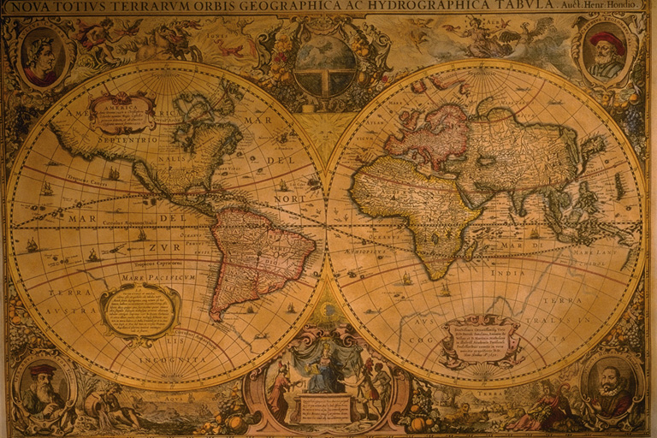
God’s Word
The Traveler’s Map
The Pilgrim's Staff
The Pilot’s Compass
The Soldier's Sword
The Christian’s Charter

Slide 37
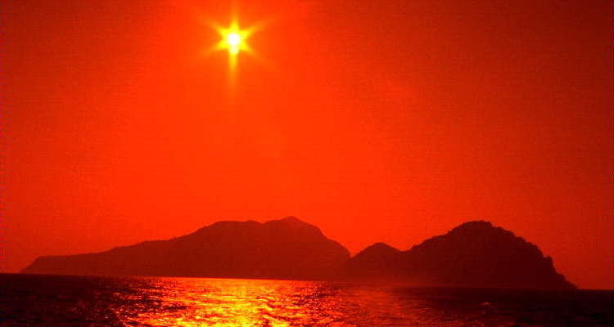
God’s Word
It Shows us…
Paradise is Restored
Heaven is Open
How to avoid the Gates of Hell

Slide 38
God’s Word
Christ is its Grand object
Reveals Plans For Our Good
Glory to God its End.

Slide 39
God’s Word
Lives in our memory
Motivates from our Heart
Guides the Feet

Slide 40
God’s Word
We should Read & Study it
Slowly
Frequently
Prayerfully
Hide it in our hearts

Slide 41
God’s Word
It is a
Mine of Wealth
Paradise of Glory
River of Peace

Slide 42
God’s Word
Given to us in life
Opened at the Judgment
Remembered Forever

Slide 43
God’s Word
Reveals the Greatest…
Responsibility
Labor
Rewards

Slide 44
God’s Word
Reveals a Creator who
loves us
begs us to listen
Wants us home with Him

Slide 45
Will We Listen?
He lets us choose, will we
Obey the Gospel
Give allegiance to God
Commit our way to Him who loves more than…?

Slide 46
Conversions in Acts
Hear Gospel
Believed
Repent
Confessed
Baptized
When?
Blessings
Three Thousand
Acts 2:1-47
Repented
2:38
Baptized
2:38, 41
That Day
2:41
Sins Forgiven
Received HS 2:38
Samaritans
8:5-12
Believed
8:12
Baptized
8:12
When they believed 8:12
Simon
8:13
Believed
8:13
Baptized
8:13
Therefore, saved
Mark 16:15-16
Ethiopian Eunuch
8:26-40
Believed
8:37
Confessed
8:37
Baptized
8:38
After confession of faith – 8:36-38
Went on way rejoicing 8:39
Saul
9:1-18; 22:1-16
Baptized
22:16
Without delay
22:16
Sins washed away 22:16
Cornelius
10:1-48; 11:1-17
Believed
15:7
Baptized
10:48
After command
10:48
Was saved
11:14
Lydia
16:14-15
Baptized
16:15
When she heard
16:14-15
Jailer
16:25-40
Believed
16:31-32
Baptized
16:33
Same hour of night – 16:33
Rejoiced
16:34
Corinthians
18:8
Believed
18:8
Baptized
18:8
When they believed and heard – 18:8
Washed, Saved
1 Cor. 6:11; 15:2
Ephesians
19:1-7
Baptized
19:5
Hear
Rom. 10:17
Belief
Jn. 3:16
Repent
Lk. 13:3
Confess
Mt. 10:32-33
Baptism
Rom. 6:3-7
Immediately
1 Peter 3:21
Salvation from Sin

Slide 47
Conversions in Acts
Hear Gospel
Believed
Repent
Confessed
Baptized
When?
Blessings
Three Thousand
Acts 2:1-47
Repented
2:38
Baptized
2:38, 41
That Day
2:41
Sins Forgiven
Received HS 2:38
Samaritans
8:5-12
Believed
8:12
Baptized
8:12
When they believed 8:12
Simon
8:13
Believed
8:13
Baptized
8:13
Therefore, saved
Mark 16:15-16
Ethiopian Eunuch
8:26-40
Believed
8:37
Confessed
8:37
Baptized
8:38
After confession of faith – 8:36-38
Went on way rejoicing 8:39
Saul
9:1-18; 22:1-16
Baptized
22:16
Without delay
22:16
Sins washed away 22:16
Cornelius
10:1-48; 11:1-17
Believed
15:7
Baptized
10:48
After command
10:48
Was saved
11:14
Lydia
16:14-15
Baptized
16:15
When she heard
16:14-15
Jailer
16:25-40
Believed
16:31-32
Baptized
16:33
Same hour of night – 16:33
Rejoiced
16:34
Corinthians
18:8
Believed
18:8
Baptized
18:8
When they believed and heard – 18:8
Washed, Saved
1 Cor. 6:11; 15:2
Ephesians
19:1-7
Baptized
19:5
Hear
Rom. 10:17
Belief
Jn. 3:16
Repent
Lk. 13:3
Confess
Mt. 10:32-33
Baptism
Rom. 6:3-7
Immediately
1 Peter 3:21
Salvation from Sin

