Slide 2
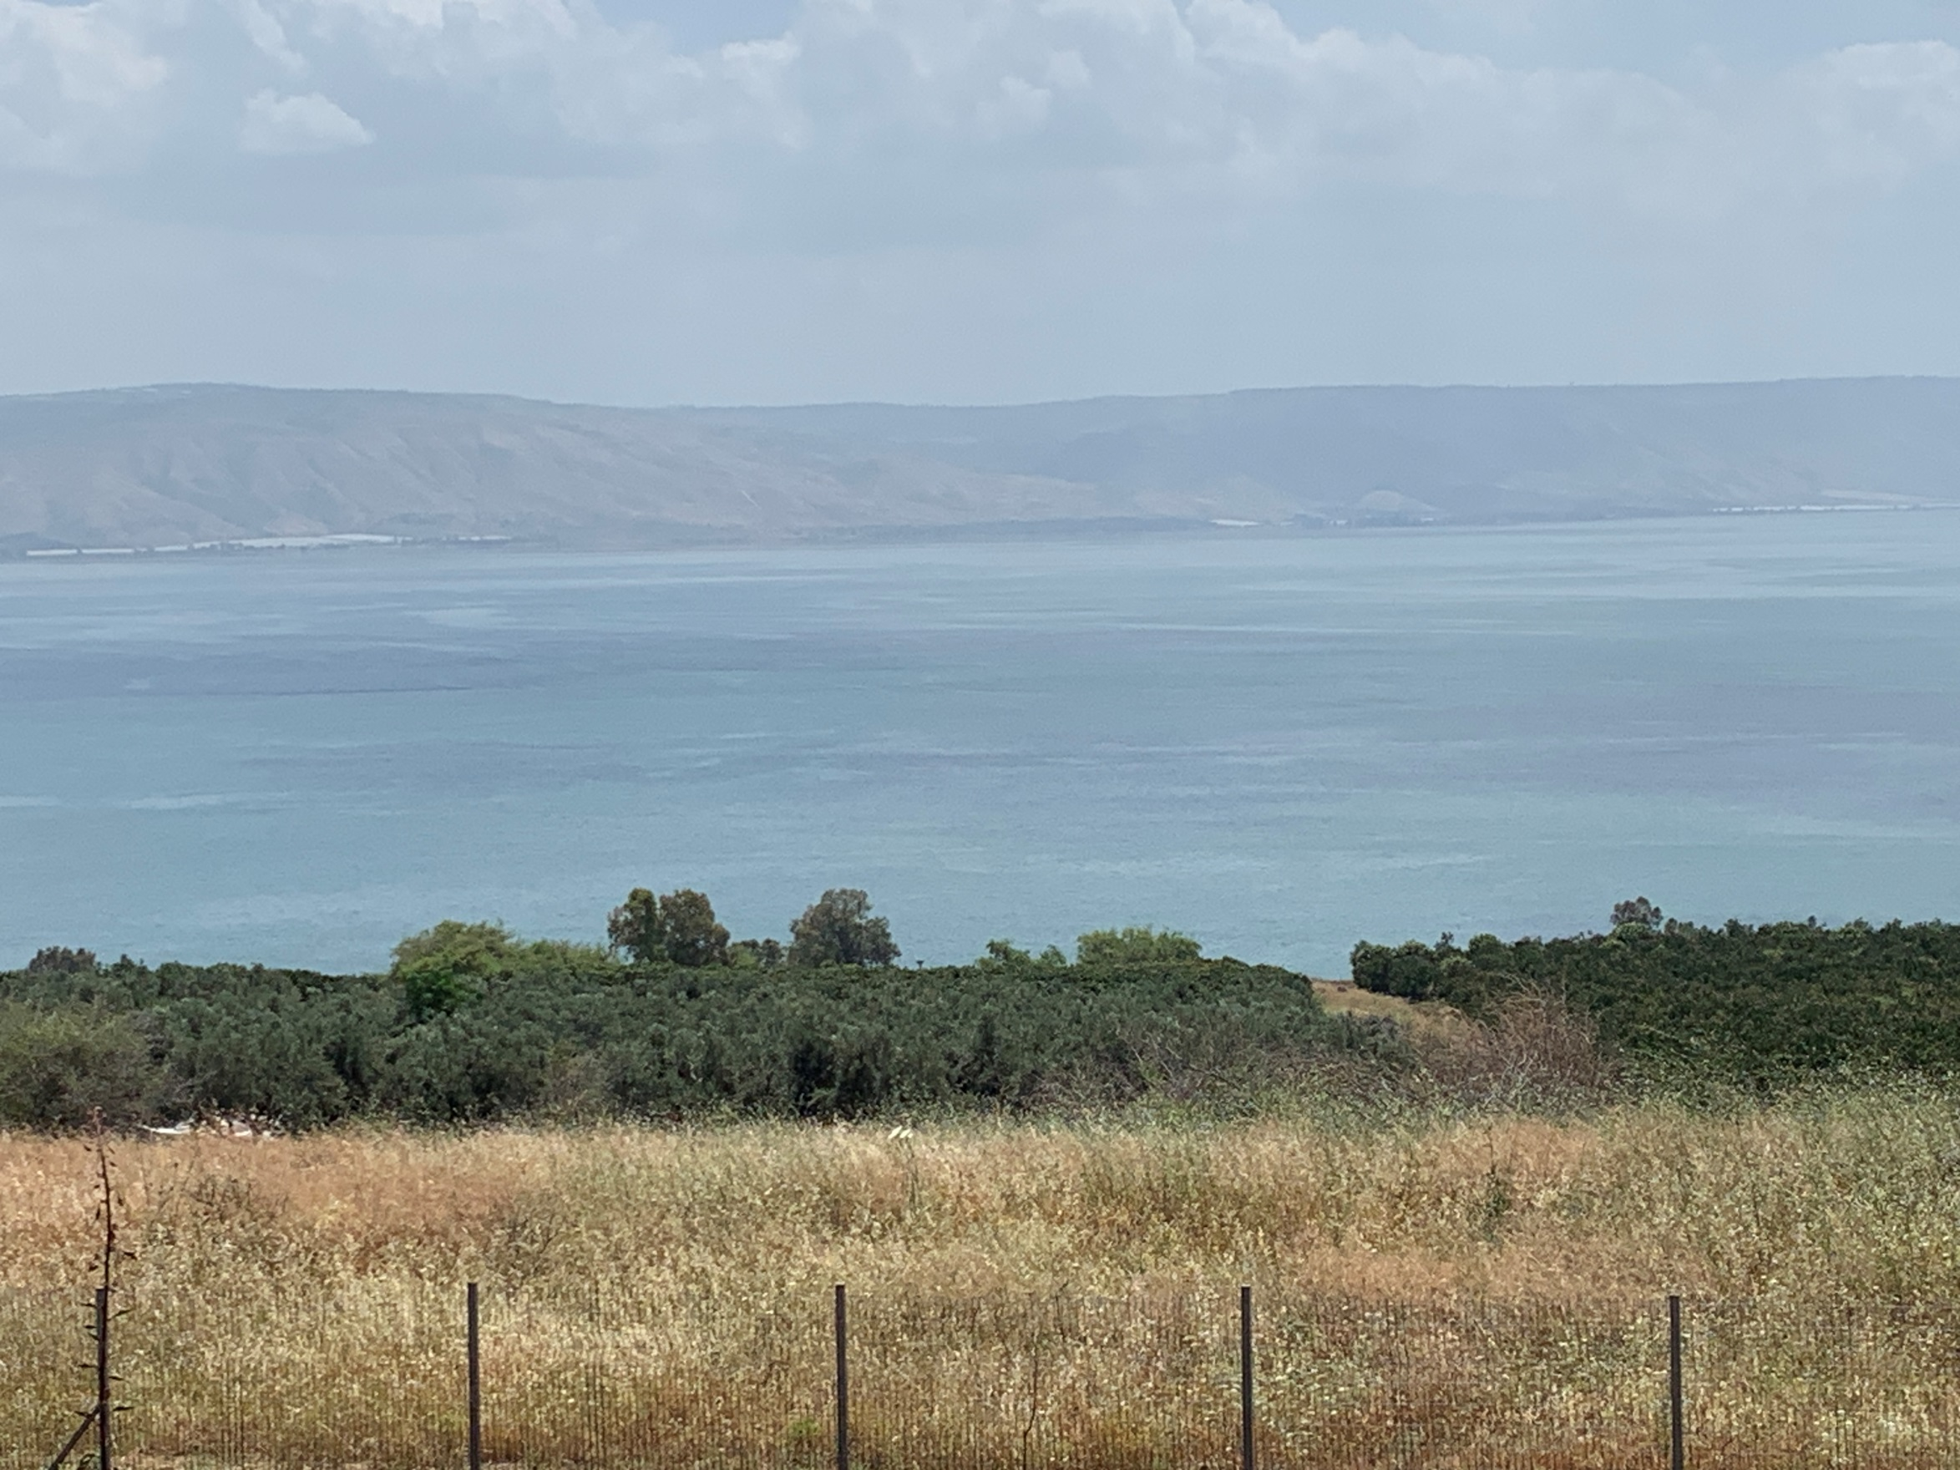
Sermon on the Mount

Slide 3
Matt. 6:16-18 Fasting
Mt 6:16 "Moreover, when you fast,
do not be like the hypocrites, with a sad countenance. For they disfigure their faces that they may appear to men to be fasting. Assuredly, I say to you,
they have their reward.
17 "But you, when you fast, anoint your head and wash your face,
18 "so that you do not appear to men to be fasting, but to your Father who is in the secret place; and your Father who sees in secret will reward you openly.
Notes:
Mt 6:16 "Moreover, when you fast,
do not be like the hypocrites, with a sad countenance.
For they disfigure their faces that
they may appear to men to be fasting.
Assuredly, I say to you, they have their reward.
17 "But you, when you fast, anoint your head and wash your face, 18
"so that you do not appear to men to be fasting,
but to your Father who is in the secret place; and
your Father who sees in secret will reward you openly.
(NKJV)

Slide 4
Fasting
Day of Atonement- Lev. 16:29-31
In Crisis – 2Chron. 20:3; Ezra 8:21; Neh. 9:1
Individuals – 2Sam. 12:16; Neh. 1:4; Psalm 35:13; 69:10
Notes:
Le 16:29 "This shall be a statute forever for you:
In the seventh month, on the tenth day of the
month, you shall afflict your souls, and do no work
at all, whether a native of your own country or
a stranger who dwells among you.
30 "For on that day the priest shall make atonement
for you, to cleanse you, that you may be clean from
all your sins before the LORD.
31 "It is a sabbath of solemn rest for you, and you shall afflict your souls. It is a statute forever.
In time of Crisis
2Ch 20:3 And Jehoshaphat feared, and set himself to seek the LORD, and proclaimed a fast throughout all Judah. (NKJV)
Ezra 8:21 Then I proclaimed a fast there at the river of Ahava, that we might humble ourselves before our God, to seek from Him the right way for us and our little ones and all our possessions. (NKJV)
Ne 9:1 Now on the twenty-fourth day of this month the children of Israel were assembled with fasting, in sackcloth, and with dust on their heads. (NKJV)
2Sa 12:16 David therefore pleaded with God for the child, and David fasted and went in and lay all night on the ground. (NKJV)
Individuals Fasting
Ne 1:4 So it was, when I heard these words, that I sat down and wept, and mourned for many days; I was fasting and praying before the God of heaven.
Ps 35:13 But as for me, when they were sick, My clothing was sackcloth; I humbled myself with fasting; And my prayer would return to my own heart.
Ps 69:10 When I wept and chastened my soul with fasting, That became my reproach. (NKJV)

Slide 5
Fasting
Afflicting of sorrow and mourning with prayer
Neh. 9:1; Est. 4:1 Dan. 9:3
Motive? Zech. 7:5
Notes:
Neh. 8:5 they stood in reverence to the law being
Read from AM to PM
Ne 9:1 Now on the twenty-fourth day
of this month the children of Israel
were assembled with fasting, in sackcloth,
and with dust on their heads. (NKJV)
Es 4:1 When Mordecai learned all that had happened,
he tore his clothes and put on sackcloth and ashes,
and went out into the midst of the city. He cried out with a loud and bitter cry. (NKJV)
Da 9:3 Then I set my face toward the Lord God to make request by prayer and supplications, with fasting, sackcloth, and ashes. (NKJV)
Zec 7:5 "Say to all the people of the land, and to the priests:
'When you fasted and mourned in the fifth and seventh months
during those seventy years,
did you really fast for Me-for Me? (NKJV)

Slide 6
Isaiah 58
Fasting with HUMILITY
Fasting with RIGHT FOCUS
SELFLESS TOWARD GOD

Slide 7
Fasting in N.T.
Never used for health
Pharisees – Luke 18:12
NOT FOR PRIDEFUL APPEARANCES
Notes:
Pharisees had a routine of fasting 2 times week.
Lu 18:12 'I fast twice a week; I give tithes of all that I possess. (NKJV)
The sin was not in that they fast but
their motive was to bring glory not to God but to themselves.
The disaster occurs when we “do our good works” to find glory for ourselves.
The disciples did not fast as a matter of regular devotion.
It was done as a natural expression of sorrow and deep concern.
Jesus did not institute any fast days for the church
either public or private.
Yet there will be times of deep concern
when fasting will be a companion of our prayers.
Our Savior’s concern is that
we worship God Himself alone and
not for prideful appearances.

Slide 9
Next week… Matthew 6:19-24 – Treasure in Heaven
Mt 6:19 "Do not lay up for yourselves treasures on earth, where moth and rust destroy and where thieves break in and steal;
20 "but lay up for yourselves treasures in heaven, where neither moth nor rust destroys and where thieves do not break in and steal.
21 "For where your treasure is,
there your heart will be also.
22 "The lamp of the body is the eye. If therefore your eye is good, your whole body will be full of light.
23 "But if your eye is bad, your whole body will be full of darkness. If therefore the light that is in you is darkness, how great is that darkness!
24 "No one can serve two masters; for either he will hate the one and love the other, or else he will be loyal to the one and despise the other. You cannot serve God and mammon. (NKJV)

