Slide 1
Jesus Christ
Our Example & Our Goal
^{1Peter 2:21} For to this you were called, because Christ also suffered for us, leaving us an example, that you should follow His steps:
^{Phil. 2:5} Let this mind be in you which was also in Christ Jesus,
^{2Cor. 10:5} casting down arguments and every high thing that exalts itself against the knowledge of God, bringing every thought into captivity to the obedience of Christ,
Notes:
1Peter 2:21
For to this you were called, because Christ also suffered for us, leaving us an example, that you should follow His steps:
Phil. 2:5 Let this mind be in you which was also in Christ Jesus,
2Cor. 10:5 casting down arguments and every high thing that exalts itself against the knowledge of God, bringing every thought into captivity to the obedience of Christ,

Slide 2
Problems
Misunderstood
Disappointed
Criticized
Enemies attacking
Gossiped and Slandered
Rejection
Distasteful and Hard
Pressured
Family Problems
Peer Pressure
Lonely
Low Standard of Living

Slide 3
Hebrews 2
14 Inasmuch then as the children have partaken of flesh and blood, He Himself likewise shared in the same, that through death He might destroy him who had the power of death, that is, the devil, (NKJV)

Slide 4
Hebrews 4
13 And there is no creature hidden from His sight, but all things are naked and open to the eyes of Him to whom we must give account.
14 Seeing then that we have a great High Priest who has passed through the heavens, Jesus the Son of God, let us hold fast our confession.
15 For we do not have a High Priest who cannot sympathize with our weaknesses, but was in all points tempted as we are, yet without sin.
16 Let us therefore come boldly to the throne of grace, that we may obtain mercy and find grace to help in time of need. (NKJV)

Slide 5
Rejection
Isa. 53:3; John 1:11; Mark 3:5; Luke 9:53; 8:26-37; 4:16-30; Mark 5:35-40
Notes:
Isaiah 53
3 He is despised and rejected by men, A Man of sorrows and
acquainted with grief. And we hid, as it were, our faces from Him;
He was despised, and we did not esteem Him. (NKJV)
John 1 11 He came to His own, and His own did not receive Him.
Mark 3 5 And when He had looked around at them with anger,
being grieved by the hardness of their hearts, He said to the man,
"Stretch out your hand." And he stretched it out, and his hand was restored as whole as the other.
Luke 9 53 But they did not receive Him, because His face was set for the journey to Jerusalem.
Luke 8 26 Then they sailed to the country of the Gadarenes, which is opposite Galilee.
27 And when He stepped out on the land, there met Him a certain man from the city who had demons for a long time. And he wore no clothes, nor did he live in a house but in the tombs.
28 When he saw Jesus, he cried out, fell down before Him, and with a loud voice said, "What have I to do with You, Jesus, Son of the Most High God? I beg You, do not torment me!"
29 For He had commanded the unclean spirit to come out of the man. For it had often seized him, and he was kept under guard, bound with chains and shackles; and he broke the bonds and was driven by the demon into the wilderness.
30 Jesus asked him, saying, "What is your name?" And he said, "Legion," because many demons had entered him.
31 And they begged Him that He would not command them to go out into the abyss.
32 Now a herd of many swine was feeding there on the mountain. So they begged Him that He would permit them to enter them. And He permitted them.
33 Then the demons went out of the man and entered the swine, and the herd ran violently down the steep place into the lake and drowned.
34 When those who fed them saw what had happened, they fled and told it in the city and in the country.
35 Then they went out to see what had happened, and came to Jesus, and found the man from whom the demons had departed, sitting at the feet of Jesus, clothed and in his right mind. And they were afraid.
36 They also who had seen it told them by what means he who had been demon-possessed was healed.
37 Then the whole multitude of the surrounding region of the Gadarenes asked Him to depart from them, for they were seized with great fear. And He got into the boat and returned. (NKJV)
Luke 4 16 So He came to Nazareth, where He had been brought up. And as His custom was, He went into the synagogue on the Sabbath day, and stood up to read.
17 And He was handed the book of the prophet Isaiah. And when He had opened the book, He found the place where it was written:
18 "The Spirit of the LORD is upon Me, Because He has anointed Me To preach the gospel to the poor; He has sent Me to heal the brokenhearted, To proclaim liberty to the captives And recovery of sight to the blind, To set at liberty those who are oppressed;
19 To proclaim the acceptable year of the LORD."
20 Then He closed the book, and gave it back to the attendant and sat down. And the eyes of all who were in the synagogue were fixed on Him.
21 And He began to say to them, "Today this Scripture is fulfilled in your hearing."
22 So all bore witness to Him, and marveled at the gracious words which proceeded out of His mouth. And they said, "Is this not Joseph's son?"
23 He said to them, "You will surely say this proverb to Me, 'Physician, heal yourself! Whatever we have heard done in Capernaum, do also here in Your country.'"
24 Then He said, "Assuredly, I say to you, no prophet is accepted in his own country.
25 "But I tell you truly, many widows were in Israel in the days of Elijah, when the heaven was shut up three years and six months, and there was a great famine throughout all the land;
26 "but to none of them was Elijah sent except to Zarephath, in the region of Sidon, to a woman who was a widow.
27 "And many lepers were in Israel in the time of Elisha the prophet, and none of them was cleansed except Naaman the Syrian."
28 So all those in the synagogue, when they heard these things, were filled with wrath,
29 and rose up and thrust Him out of the city; and they led Him to the brow of the hill on which their city was built, that they might throw Him down over the cliff.
30 Then passing through the midst of them, He went His way. (NKJV)
Mark 5 35 While He was still speaking, some came from the ruler of the synagogue's house who said, "Your daughter is dead. Why trouble the Teacher any further?"
36 As soon as Jesus heard the word that was spoken, He said to the ruler of the synagogue, "Do not be afraid; only believe."
37 And He permitted no one to follow Him except Peter, James, and John the brother of James.
38 Then He came to the house of the ruler of the synagogue, and saw a tumult and those who wept and wailed loudly.
39 When He came in, He said to them, "Why make this commotion and weep? The child is not dead, but sleeping."
40 And they ridiculed Him. But when He had put them all outside, He took the father and the mother of the child, and those who were with Him, and entered where the child was lying. (NKJV)

Slide 6
Pressure - Stress
  Mark 7:24;2:1-2; 3:20; 3:9; Luke 4:42; 12:1;
  John 9:4
Notes:
Mark 7
24 From there He arose and went to the region of Tyre and Sidon.
And He entered a house and wanted no one to know it,
but He could not be hidden. (NKJV)
Mark 2
1 And again He entered Capernaum after some days, and it was heard that He was in the house.
2 Immediately many gathered together, so that there was no longer room to receive them, not even near the door. And He preached the word to them. (NKJV)
Mark 3 20 Then the multitude came together again, so that they could not so much as eat bread. (NKJV)
Mark 3 9 So He told His disciples that a small boat should be kept ready for Him because of the multitude, lest they should crush Him. (NKJV)
Luke 4 42 Now when it was day, He departed and went into a deserted place. And the crowd sought Him and came to Him, and tried to keep Him from leaving them; (NKJV)
Luke 12 1 In the meantime, when an innumerable multitude of people had gathered together, so that they trampled one another, He began to say to His disciples first of all, "Beware of the leaven of the Pharisees, which is hypocrisy. (NKJV)
John 9 4 "I must work the works of Him who sent Me while it is day; the night is coming when no one can work. (NKJV)

Slide 7
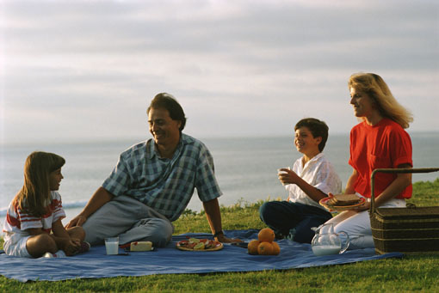
Family Problems
  John 7:3-5
Notes:
Joh 7:3 His brothers therefore said to Him, "Depart from here and go into Judea, that Your disciples also may see the works that You are doing.
4 "For no one does anything in secret while he himself seeks to be known openly. If You do these things, show Yourself to the world."
5 For even His brothers did not believe in Him.
(NKJV)

Slide 8
Peer Frustrations
  Mark 3:17
  John 13:1
Notes:
Mark 3
17 James the son of Zebedee and John the brother of James, to whom He gave the name Boanerges, that is, "Sons of Thunder";
(NKJV)
John 13
1 Now before the feast of the Passover, when Jesus knew that His hour had come that He should depart from this world to the Father, having loved His own who were in the world, He loved them to the end.
(NKJV)

Slide 9
Lonely
  Mark 6:47; 1:35; Matt. 14:13;
  Mark 9:33-34
Notes:
Mark 6
47 Now when evening came, the boat was in the middle of the sea; and He was alone on the land. (NKJV)
Mark 1
35 Now in the morning, having risen a long while before daylight, He went out and departed to a solitary place; and there He prayed. (NKJV)
Matthew 14
13 When Jesus heard it, He departed from there by boat to a deserted place by Himself. But when the multitudes heard it, they followed Him on foot from the cities. (NKJV)
Mark 9
33 Then He came to Capernaum. And when He was in the house He asked them, "What was it you disputed among yourselves on the road?"
34 But they kept silent, for on the road they had disputed among themselves who would be the greatest. (NKJV)

Slide 10
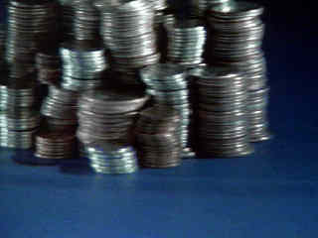
No Physical Wealth
  Matt. 8:20
Notes:
Matthew 8
20 And Jesus said to him, "Foxes have holes and birds of the air have nests, but the Son of Man has nowhere to lay His head."
(NKJV)

Slide 11
Misunderstood
  John 11:33-35
Notes:
John 11
33 Therefore, when Jesus saw her weeping, and the Jews who came with her weeping, He groaned in the spirit and was troubled.
34 And He said, "Where have you laid him?" They said to Him, "Lord, come and see."
35 Jesus wept.
(NKJV)

Slide 12
Criticized
  Rev. 12:10; Matt. 11:19; John 8:48
  Mark 2:6 Accused of Blasphemies
    2:16 Eating with sinners
    2:23 Breaking the Sabbath
    3:2 Watched that they might accuse
    3:6 Looked for way to Kill
    3:20 Accused of In league with devil
Enemies attacking
Gossiped and Slandered
Notes:
Revelation 12
10 Then I heard a loud voice saying in heaven,
"Now salvation, and strength, and the
kingdom of our God, and the power of His
Christ have come, for the accuser of our
brethren, who accused them before our God
day and night, has been cast down. (NKJV)
Matthew 11
19 "The Son of Man came eating and drinking, and they say, 'Look, a glutton and a winebibber, a friend of tax collectors and sinners!' But wisdom is justified by her children.“ (NKJV)
John 8
48 Then the Jews answered and said to Him, "Do we not say rightly that You are a Samaritan and have a demon?“ (NKJV)
Mark 2
6 And some of the scribes were sitting there and reasoning in their hearts,
16 And when the scribes and Pharisees saw Him eating with the tax collectors and sinners, they said to His disciples, "How is it that He eats and drinks with tax collectors and sinners?" (NKJV)
23 Now it happened that He went through the grainfields on the Sabbath; and as they went His disciples began to pluck the heads of grain. (NKJV)
Mark 3
2 So they watched Him closely, whether He would heal him on the Sabbath, so that they might accuse Him.
6 Then the Pharisees went out and immediately plotted with the Herodians against Him, how they might destroy Him. (NKJV)
20 Then the multitude came together again, so that they could not so much as eat bread. (NKJV)

Slide 13
Promised :
“We too will have Problems”
John 15:18-19
Matt. 10:24-25
Phil. 1:29
1 Peter 4:13-16
2 Tim. 3:12
Notes:
John 15
18 "If the world hates you, you know that it hated
Me before it hated you.
19 "If you were of the world,
the world would love its own.
Yet because you are not of the world,
but I chose you out of the world,
therefore the world hates you. (NKJV)
Matthew 10 24 "A disciple is not above his teacher, nor a servant above his master.
25 "It is enough for a disciple that he be like his teacher, and a servant like his master. If they have called the master of the house Beelzebub, how much more will they call those of his household! (NKJV)
Philippians 1
29 For to you it has been granted on behalf of Christ, not only to believe in Him, but also to suffer for His sake, (NKJV)
1 Peter 4
13 but rejoice to the extent that you partake of Christ's sufferings, that when His glory is revealed, you may also be glad with exceeding joy.
14 If you are reproached for the name of Christ, blessed are you, for the Spirit of glory and of God rests upon you. On their part He is blasphemed, but on your part He is glorified.
15 But let none of you suffer as a murderer, a thief, an evildoer, or as a busybody in other people's matters.
16 Yet if anyone suffers as a Christian, let him not be ashamed, but let him glorify God in this matter.
2 Timothy 3:12
Yes, and all who desire to live godly in Christ Jesus will suffer persecution. (NKJV)

Slide 14
Why Does God Allow A Christian to Suffer
Allow test of our faith
Wants us to grow
Create and deepen our dependence upon Him
See where we put our trust
Allowed as compliment to faith - Job
To identify with Jesus
  Hebrews 5:8; 1 Peter 2:21
Notes:
Hebrews 5
8 though He was a Son, yet He learned obedience by the things which He suffered. (NKJV)
1 Peter 2
21 For to this you were called, because Christ also suffered for us, leaving us an example, that you should follow His steps: (NKJV)

Slide 15
What Jesus Did NOT Do...
Worry - Matt. 6
Fear -1 John 4:18
Retaliate - 1 Pet.2:23; Mt.5:44
Have self pity - Trust Jn. 12:23
Get Discouraged - Isaiah 42:4
Chase Rumors - Phil.2:7
Grumble / Complain - Matt. 5
Notes:
Matt. 6:
1 John 4 18 There is no fear in love; but perfect love casts out fear, because fear involves torment. But he who fears has not been made perfect in love.
1 Peter 2 23 who, when He was reviled, did not revile in return; when He suffered, He did not threaten, but committed Himself to Him who judges righteously; (NKJV)
Matthew 5 44 "But I say to you, love your enemies, bless those who curse you, do good to those who hate you, and pray for those who spitefully use you and persecute you, (NKJV)
John 12 23 But Jesus answered them, saying, "The hour has come that the Son of Man should be glorified. (NKJV)
Isaiah 42 4 He will not fail nor be discouraged, Till He has established justice in the earth; And the coastlands shall wait for His law." (NKJV)
Philippians 2 7 but made Himself of no reputation, taking the form of a bondservant, and coming in the likeness of men. (NKJV)

Slide 16
What Jesus Did…
Complete Trust In God
  1 Peter 2:23
Constant, Consistent Communion with Father
    John 10:27-30
Prayed Often
  Luke 4:42; Acts 6
Knew, Used & Relied on Scripture
  John 12:49
Notes:
1 Peter 2
23 who, when He was reviled, did not revile in return; when He suffered, He did not threaten, but committed Himself to Him who judges righteously; (NKJV)
John 10
27 "My sheep hear My voice, and I know them, and they follow Me.
28 "And I give them eternal life, and they shall never perish; neither shall anyone snatch them out of My hand.
29 "My Father, who has given them to Me, is greater than all; and no one is able to snatch them out of My Father's hand.
30 "I and My Father are one.“ (NKJV)
Luke 4
42 Now when it was day, He departed and went into a deserted place. And the crowd sought Him and came to Him, and tried to keep Him from leaving them;
John 12 49 "For I have not spoken on My own authority; but the Father who sent Me gave Me a command, what I should say and what I should speak. (NKJV)

Slide 17
When We Are Troubled
Trust Prov. 3:5
Be Content Heb. 13:5-6
Take God’s Easy yoke Matt. 11:28
Don’t be troubled or afraid Jn. 14:27
Don’t Worry Phil. 4:6-7
Cast Burden before Christ 1Pet. 5:7
Notes:
Proverbs 3
5 Trust in the LORD with all your heart,
And lean not on your own understanding; (NKJV)
Hebrews 13 5 Let your conduct be without covetousness; be content with such things as you have. For He Himself has said, "I will never leave you nor forsake you."
6 So we may boldly say: "The LORD is my helper; I will not fear. What can man do to me?“ (NKJV)
Matthew 11 28 "Come to Me, all you who labor and are heavy laden, and I will give you rest.
John 14
27 "Peace I leave with you, My peace I give to you; not as the world gives do I give to you. Let not your heart be troubled, neither let it be afraid.
Philippians 4
6 Be anxious for nothing, but in everything by prayer and supplication, with thanksgiving, let your requests be made known to God;
7 and the peace of God, which surpasses all understanding, will guard your hearts and minds through Christ Jesus.
1 Peter 5
7 casting all your care upon Him, for He cares for you. (NKJV)

Slide 18
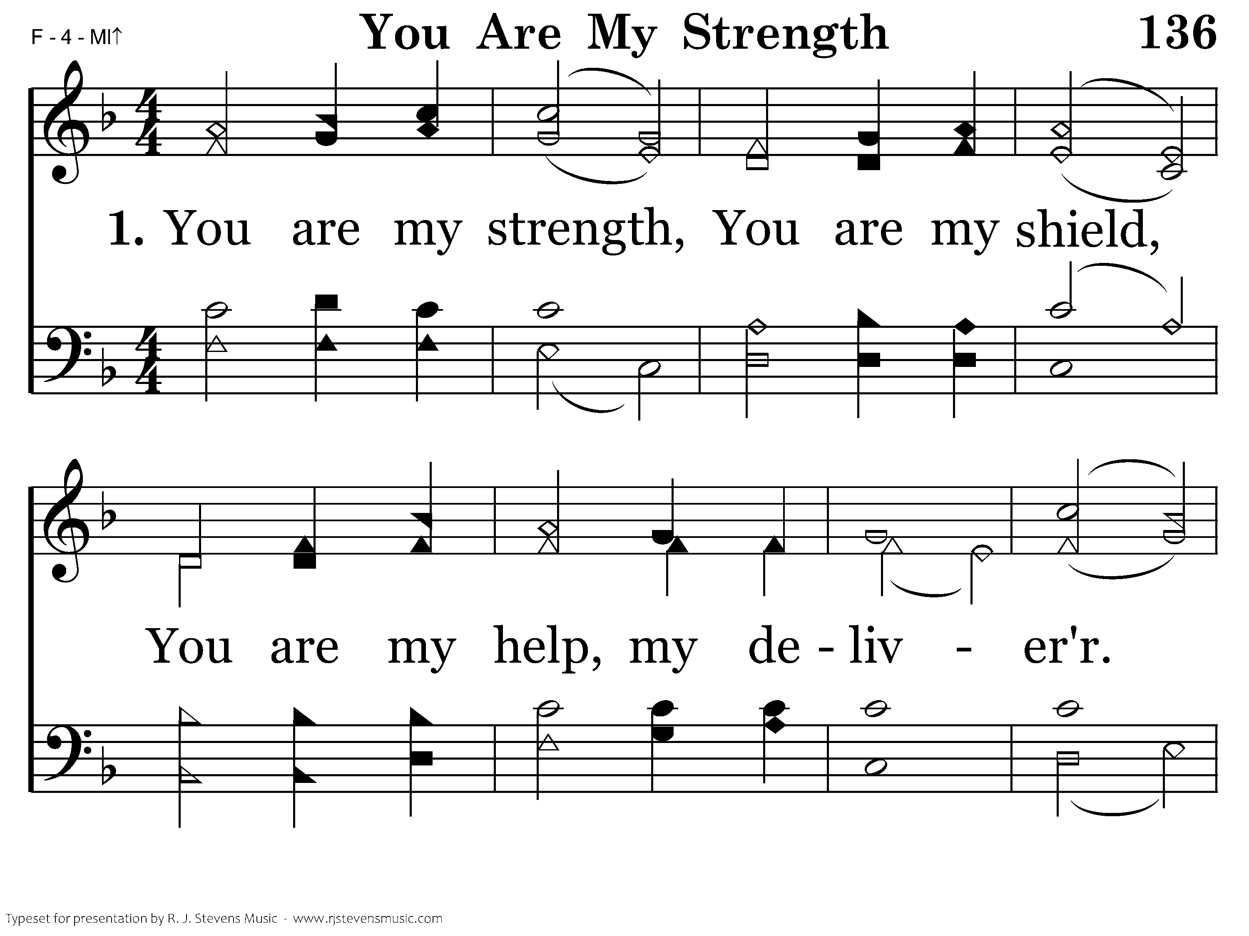
1136 - You Are My Strength - 1.1

Slide 19
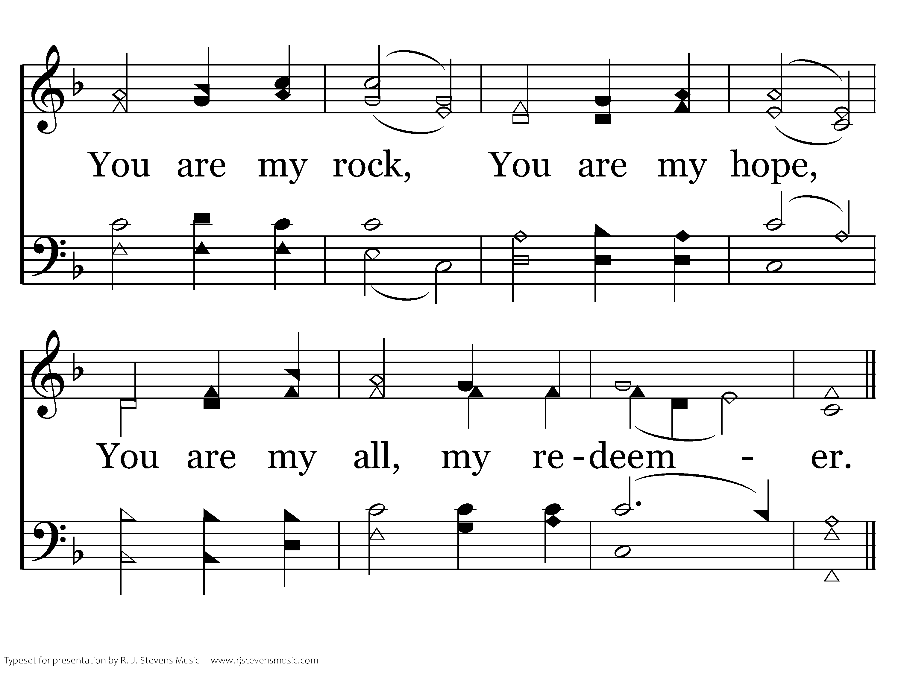
1136 - You Are My Strength - 1.2
End of Verse 1

Slide 20
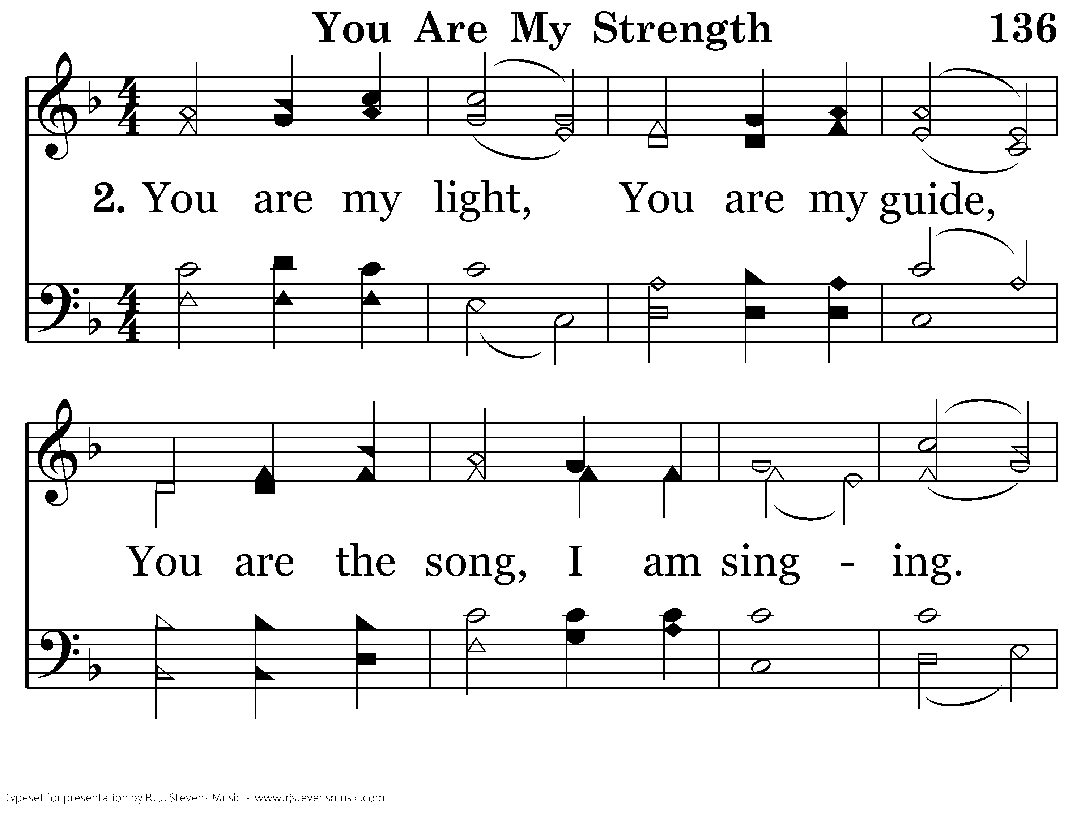
1136 - You Are My Strength - 2.1

Slide 21
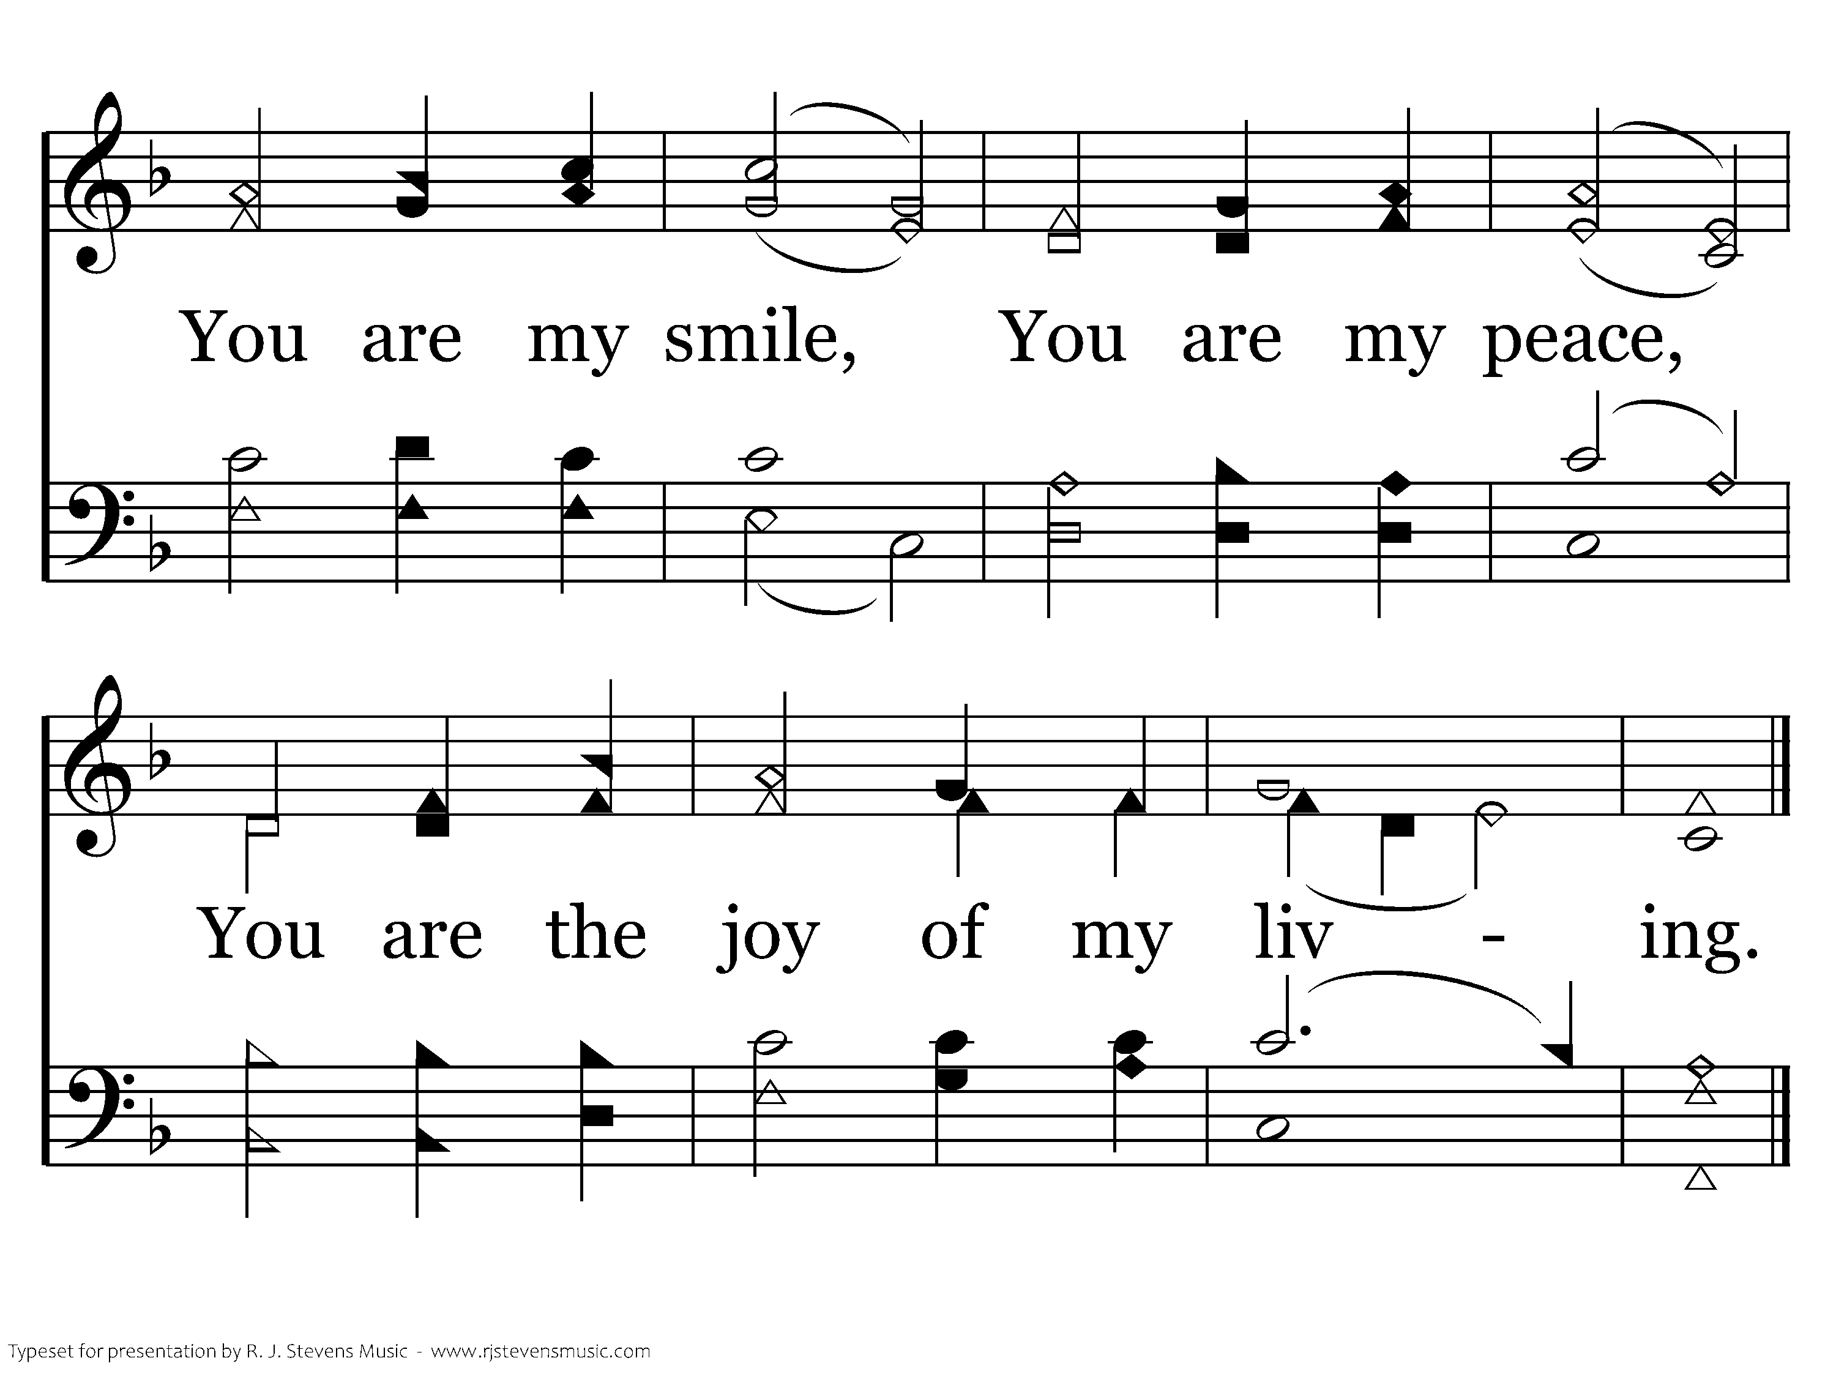
1136 - You Are My Strength - 2.2
End of Song

Slide 22
Marriage Trek
Love
Love
Love
Love
YOU MEET
WEDDING
Propose
Engagement
Name
Change

Slide 23

Salvation Trek
Faith
Faith
Hear
God's
Word
Rom. 10:17
Faith
Faith
BAPTIZED
Godly
Sorrow
2 Cor. 7:10
Repent
Acts 2:38
Luke 13:3
Confess
Faith
Mt. 10:32
Bride of Christ
In Christ
Saved
Sins Forgiven

