Slide 1
Redeeming the Time
Ephesians 5:15-16 See then that you walk circumspectly, not as fools but as wise,
16 redeeming the time, because the days are evil.
Colossians 4:5-6 Walk in wisdom toward those who are outside, redeeming the time.
6 Let your speech always be with grace, seasoned with salt, that you may know how you ought to answer each one.

Slide 2
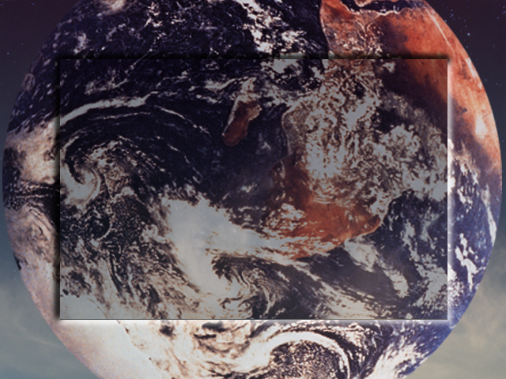
Gen. 1:1
In the Beginning
Revelation 10:6 … there should be time no longer (KJV)

Slide 3
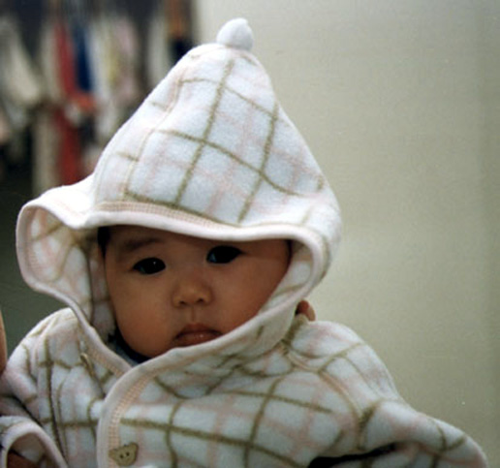
Job 14:1-2
Man who is born of woman, Is of few days and full of trouble.
2 He comes forth like a flower and fades away;
He flees like a shadow and does not continue.

Slide 4
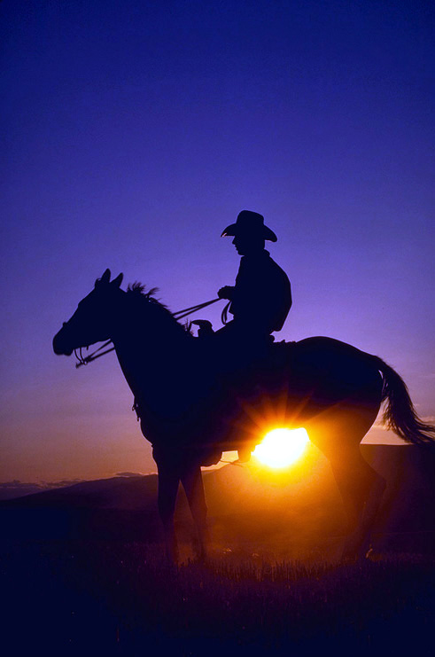
Psalm 90:10, 12
10 The days of our lives are seventy years;
And if by reason of strength they are eighty years,
Yet their boast is only labor and sorrow;
For it is soon cut off, and we fly away.
12 So teach us to number our days,
That we may gain a heart of wisdom.
We all will ride off into the sunset

Slide 5
Psalm 39:4
4 “Lord, make me to know my end,
And what is the measure of my days,
That I may know how frail I am.

Slide 6
James 4:14
14 whereas you do not know what will happen tomorrow. For what is your life? It is even a vapor that appears for a little time and then vanishes away.

Slide 7
Time
5550 { khron’-os}
  1) time either long or short
2540 { kahee-ros’}
    1) due measure 2)a measure of time, a larger or smaller portion of time, hence:
      2a)a fixed and definite time, the time when things are brought to crisis, the decisive epoch waited for
      2b) opportune or seasonable time
      2c) the right time
      2d) a limited period of time

Slide 8
Time With A Purpose!

Slide 9
Make Money?
Yes?
No?
q
q
P

Slide 10
Gain Power & Authority?
Yes?
No?
q
q
P

Slide 11
Become Famous?
Yes?
No?
q
q
P

Slide 12
Find Happiness?
q
q
Yes?
No?
P

Slide 13
Recreation?
Yes?
No?
q
q
P

Slide 15
Eccl. 12:13-14
Fear God -
  Awesome Respect
Keep Commandments
Reason - Judgement!

Slide 16
How?

Slide 17
Singled Eye Devotion
Matthew 6:22
The light of the body is the eye: if therefore thine eye be single, thy whole body shall be full of light.
Matthew 6:33
33 “But seek first the kingdom of God and His righteousness, and all these things shall be added to you.

Slide 18
Matthew 7:13-14
“Enter by the narrow gate; for wide is the gate and broad is the way that leads to destruction, and there are many who go in by it.14 “Because narrow is the gate and difficult is the way which leads to life, and there are few who find it.

Slide 19
Philippians 3:13
13 Brethren, I do not count myself to have apprehended; but one thing I do, forgetting those things which are behind and reaching forward to those things which are ahead,

Slide 20
Philippians 3:13
13 Brethren, I do not count myself to have apprehended; but one thing I do, forgetting those things which are behind and reaching forward to those things which are ahead,

Slide 21
2 Peter 3:8
8 But, beloved, do not forget this one thing, that with the Lord one day is as a thousand years, and a thousand years as one day.

Slide 22
We MUST
Deny Everything that gets in the way of heaven

Slide 23
Concentration & Focus
Lasers
Doctors Specialize
Top Salesmen

Slide 24
Recognize we All have 24 hours Each Day!
We can’t make time!

Slide 25
It’s Not Lack of Time
Conviction
Tenacity
Determination
Resolve

Slide 26
It’s Fuelled by
What We Treasure Most
Most Precious To Us
Where your treasure is
there will your heart be also
Mt. 6:21

Slide 27
Make List of Priorities and # in importance
List Where Time Wasted
List what should be put in wasted time slots.
James 4:17

Slide 28
Noah’s Salvation & Ours
1 Peter 3:18-21

Slide 29
Grace
Genesis 6:8
8 But Noah found grace in the eyes of the Lord.
Ephesians 2:8
8 For by grace you have been saved through faith, and that not of yourselves; it is the gift of God,

Slide 30
Faith
Hebrews 11:7
By faith Noah, being divinely warned of things not yet seen, moved with godly fear, prepared an ark for the saving of his household, by which he condemned the world and became heir of the righteousness which is according to faith.
Acts 16:31
31 So they said, “Believe on the Lord Jesus Christ, and you will be saved, you and your household.”

Slide 31
Obedience
Genesis 6:22
Thus Noah did; according to all that God commanded him, so he did.
Hebrews 5:9
And having been perfected, He became the author of eternal salvation to all who obey Him,

Slide 32

Water
1 Peter 3:20 who formerly were disobedient, when once the Divine longsuffering waited in the days of Noah, while the ark was being prepared, in which a few, that is, eight souls, were saved through water.
1 Peter 3:21 There is also an antitype which now saves us— baptism
(not the removal of the filth of the flesh, but the answer of a good conscience toward God), through the resurrection of Jesus Christ,

Slide 33
Acts 22:16
'And now why are you waiting? Arise and be baptized, and wash away your sins, calling on the name of the Lord.‘

